Slide 1
Special Permissions and Managing Services
Linux 1 Day 3

Slide 2
Class Objectives
By the end of class, you will be able to:
Set file permissions on programs using the SUID or GUID bits.
Manage and monitor services on the system, and remove unused services.
Create and assign users for services.
Secure the boot loader against single user attacks.

Slide 3
In the previous class we learned...

Slide 4
Permissions
How permissions apply to each specific file and folder with r, w, and x.
Symbolic Notation
r | read
w | write
x | execute
rwx rw- r--
User can read, write execute
Group can read and write
Others can read

Slide 5
Permissions
How to view and apply permissions to an item’s user, group, and other.
Users
Groups
Root
Every file and program on a Linux system has permissions.
These permissions tell the system which users can access the file or run the program.
Users can be placed in groups, which can have special permissions that apply to all members of the group.
File and program permissions apply to all users in a system, except the root user.
The root user (or super user) has complete access and can perform any action.

Slide 6
Permissions
We can use sudo user to invoke the root user and bypass any permissions.
ls -l | To show the permissions info.
chmod | To change the permissions info.
chown | To change the owner and group of a file.

Slide 7
Permissions
We can assign sudo for a specific command for a specific user.
whoami | To determine the current user.
su | To switch to another user, in this case the root user.
sudo | To invoke the root user for one command only.
sudo -l | To list the sudo privileges for a user.
visudo | To edit the sudoers file.

Slide 8
Special Bits

Slide 9

Can anyone think of a scenario where all the users on a system would need to run a specific program as root?

Slide 10

Password Command
The passwd command allows a user to change their password.
passwd must have root privileges in order to edit the /etc/shadow file and update the password hash.
/etc/shadow | In order to change a password in the system, the passwd program has to edit the /etc/shadow file where the password hashes are stored.
Remember, we never edit the /etc/shadow file manually. It is only edited by the system when a user is created or removed, or when a user's password is changed and it is owned by the root user.

Slide 11

Password Command
Rather than manually giving all users sudo access for this command and making sure every new user also gets sudo access, we can have passwd set to always run on root, regardless of the user running the command.
Notes:
shutterstock_1336201028

Slide 12
Special Permissions
We use special permissions for three basic scenarios:
Allowing multiple users to make changes to the same files inside a shared directory.
Limiting users to only making changes to their own files within a shared directory.
Allowing any user on the system to run a specific program as the root user.

Slide 13
For each of these three scenarios, there is a different special bit setting that we can add to an item's permissions.

Slide 14
Special Permissions
The r, w, and x bits are the standard characters for permissions. The special bits are those we add to permissions for the three scenarios mentioned before.
File type
Permission classes
Read
Write
User Group Other
Execute
drwxrwxrwx rwx

Slide 15
Special Permissions
Special bits are displayed alongside the permissions of an item, in the place of the execute bit.
In these cases, the x setting is still present, it's just not displayed.
The special bit and the execute settings are used in conjunction with each other. To use a special bit, we would first allow execute permissions before setting the special bit.
There are three special bit options, one for the owner, group, and other permissions.

Slide 16
Special Permissions
We can enable or disable these bits by using the same chmod command we learned in the last class. We can use either symbolic or octal notation.
ls -l | To show the permissions info.
chmod | To change the permissions info.
chown | To change the owner and group of a file.

Slide 17
The Sticky bit lives in the execute position for the other permissions.

Slide 18
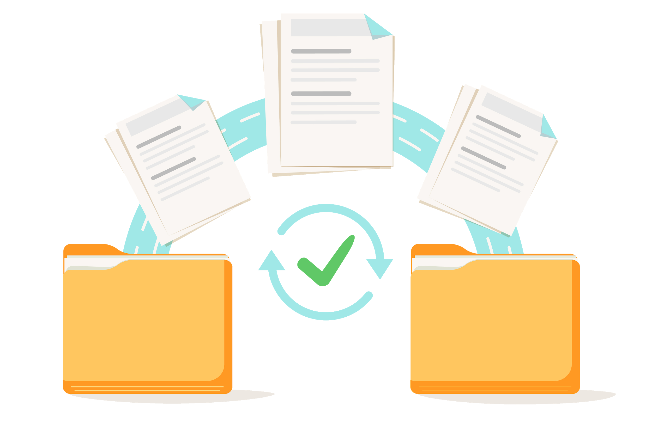
Sticky Bit
Restricts users from making changes to other users’ files inside a shared directory.
x

Slide 19
Sticky Bit
Displayed with a t in the place of the x for the other permissions: drwxrwxrwt.
File type
Permission classes
User Group Other
drwxrwxrwt

Slide 20
Sticky Bit
If set without setting the x first, it will be indicated with a capital T: drwxrwxrwT.
File type
Permission classes
User Group Other
drwxrwxrwT

Slide 21
Sticky Bit
Can be set with chmod o+t or chmod 1000.
# mkdir es_data # mkdir es-data # chmod o+t es_data # chmod 1000 es-data
# ls -l d--------T 2 1000 1000 4096 Jun 8 09:50 es-data drwxr-xr-t 8 root root 4096 Jun 8 09:50 es_data

Slide 22
The Set Group ID (SGID) bit lives in the execute position for the group permissions.

Slide 23

Set Group ID
Sales
Grants all users the same permissions as the group assigned to a shared directory.
Marketing
Designed to allow multiple users to make changes to the same directory.
Accounting

Slide 24
Set Group ID
Displayed with an s in the place of the x for the group permissions: -rwxrwsr-x.
File type
Permission classes
User Group Other
-rwxrwsr-x

Slide 25
Set Group ID
If set without setting the x first, it will be indicated with a capital S: -rwxrwSr-x.
File type
Permission classes
User Group Other
-rwxrwSr-x

Slide 26
Set Group ID
It can be set with chmod g+s or chmod 2000.
# mkdir es_data # mkdir es-data # chmod g+s es_data # chmod 2000 es-data
# ls -l d-----S--- 2 root root 64 Jun 8 09:50 es-data drwxr-sr-x 8 root root 64 Jun 8 09:50 es_data

Slide 27

The SGID and sticky bits can be used together to allow a group of users to collaborate in the same directory.
When set together, they allow users to make changes to the same directory, but only to files they own.
Notes:
shutterstock_1051414391

Slide 28

The SUID bit is the most important bit for security.
Notes:
shutterstock_778654396

Slide 29

Special Bits Demo
A web developer at your company asked for sudo access to run the find command on a web server. They want to search the entire system for misplaced configuration files.
They also said that other developers want the same privilege, and suggested setting the SUID bit on the find command so everyone can use find with root privileges.

Slide 30
Special Bits Demo
In the following demo, we will:
Turn on the SUID setting of the find command.
Confirm that this introduces a vulnerability to the system.
Turn off the SUID setting for the find command.
Search the system for other programs that have the SUID bit set.

Slide 31
Special Bits Demo

Slide 32
Activity: Shutting Out SUID
Your senior administrator is worried about the SUID bit being set on programs owned by root, and has asked that you audit the system for all files that have the SUID bit set for the root user.
You must audit the system for known programs that should not have this bit set.
15 minutes

Slide 34
Shutting Out SUID Review
Completing the previous activity required the following steps:
Running the find command to find all SUID bit-enabled programs.
Comparing the lists and verifying one of the programs found is not on the first list.
Switching to another user and attempt to exploit the program found.
Running the correct command to remove the SUID bit and verifying this worked.

Slide 35
Managing Services

Slide 36

Servers are computers that offer services to other computers.

Slide 37

Managing Services
A service is a function or capability that a machine makes available to another.
For example, file sharing services allow computers to send and receive data.
Notes:
shutterstock_160754045

Slide 38
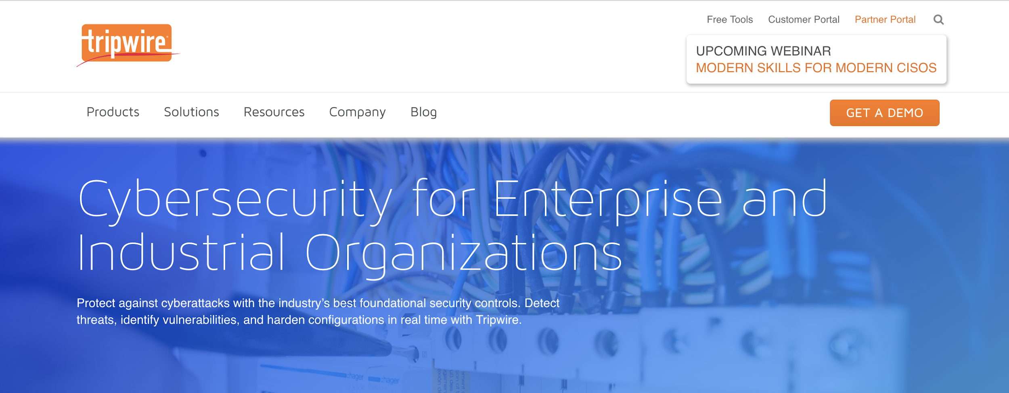
Managing Services
Some services, like Tripwire, are only run locally on the server and are not provided to other computers. These services are packages that can be installed and removed just like other programs.
tripwire.com

Slide 39
Services and Security

Slide 40

Services and Security
Attackers can manipulate services into doing things that they are not designed to do.
Notes:
shutterstock_1085385533

Slide 41
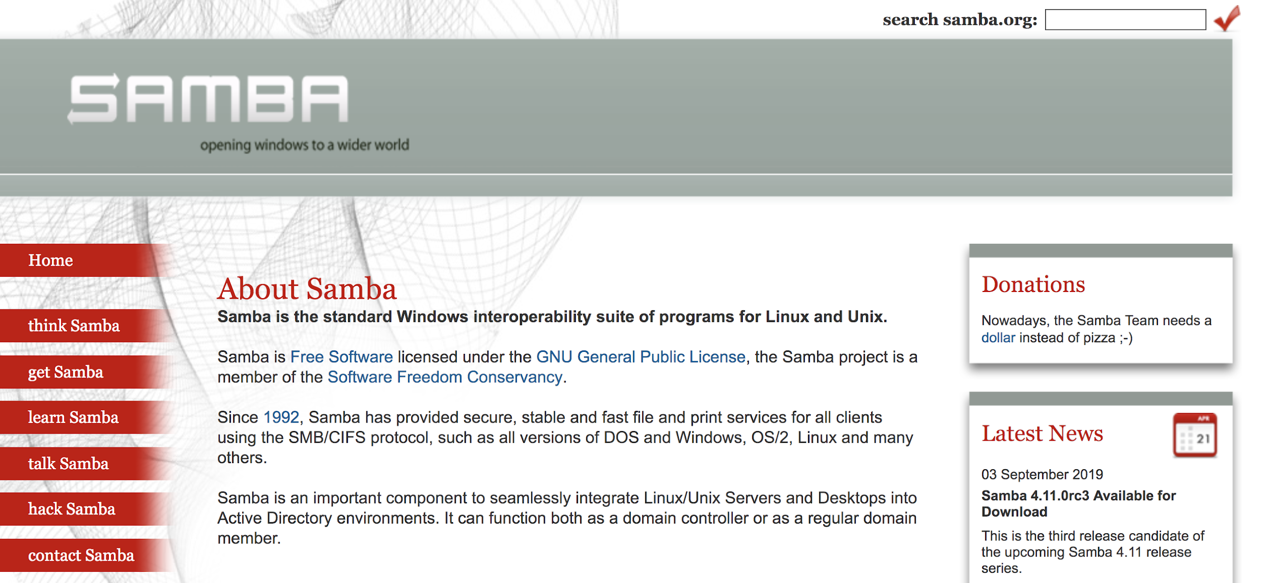
Services and Security
For example: Samba (SMB), the file sharing protocol, allows users to view, download, and store files remotely.
samba.org

Slide 42

Services and Security
If a malicious user is able to gain access to a shared folder, they can exfiltrate, alter, or delete sensitive files.
Notes:
shutterstock_118392385

Slide 43

Finding and Stopping SMB Demo
In this example, the server has already been compromised.
In the following demo, we will stop the SMB service, and then uninstall it from the system.
Notes:
shutterstock_247399030

Slide 44
Finding and Stopping SMB Demo
This will require the following steps:
Listing all running services.
Identifying the Samba service in the list to confirm it's running, then stopping it.
Ensuring Samba doesn't start when the machine is started up.
Ensuring Samba is no longer running.
Uninstalling the Samba service completely.

Slide 45
Finding and Stopping SMB Demo

Slide 46
Activity: Managing Services
Your senior administrator wants you to audit the services being run by the server and shut down old and unused services.
They have provided a list of services to check.
Check this list of services, and shut down and remove any service that you find running.
15 minutes

Slide 48
Review: Managing Services
Completing this activity required the following steps:
Identifying four services in the list that are installed/running on the machine.
Stopping each service.
Disabling each service.
Uninstalling each service.

Slide 50
Service Users

Slide 51

Some services are not run by real users. They are run by specific service users that are dedicated to running their own specific service.

Slide 52

Service Users
Typically, when you install a service with the package manager, a service user is automatically created and configured.
Running services under a dedicated user offers several security benefits. It makes it easier to start, stop, and manage the service, and control which files the permissions need to access.
Notes:
shutterstock_1381814072

Slide 53
A service user usually has a system UID less than 1000 and cannot log in to use a shell.

Slide 54

Service Users
Since service users aren't humans who need to log into and interact with the machine, it's best practice to ensure that users cannot log into an interactive shell using a service username.
Notes:
shutterstock_105536243

Slide 55

Setting Up and Adding Service Users Demo
Your senior administrator asked you to follow up on your uninstallation of unused services. You must now ensure the services’ corresponding users have also been removed from the system.
Previously, you uninstalled apache2, but its service user, www-data, still exists.
Notes:
shutterstock_1439640908

Slide 56

Setting Up and Adding Service Users Demo
Your senior administrator also plans to install a security service called Splunk to collect and analyze logs for suspicious activity. Like Tripwire, Splunk makes it easier for admins and security personnel to detect and stop malicious behavior.
splunk.com

Slide 57

Setting Up and Adding Service Users Demo
Your senior administrator told you that they'll handle the installation and configuration themselves, but have requested that you create a service user that they can use later.
Notes:
shutterstock_1039376995

Slide 58
Setting Up and Adding Service Users Demo
Completing this task will require the following steps:
Delete
Create
Deleting an old, unused service user with deluser/.
Creating and validating a new service user with adduser.

Slide 59
Setting up and Adding Service Users

Slide 60
Activity: Managing Services
Your senior administrator would like you to remove any old service users from the system and create a new user dedicated to running Tripwire.
Use adduser and deluser with the correct flags to clean up the system and create this new Tripwire user.
Tripwire can only be run as root , so you must add a line to the sudoers file to allow this.
15 minutes

Slide 62
Review: Managing Services
Completing this activity required the following steps:
Using deluser to remove four lingering users.
Using adduser with the correct flags to create a new Tripwire service user.
Editing the sudoers file to allow the Tripwire user to run the program with sudo.
Changing the tripwire user permissions to only allow the owner of Tripwire to run it.

Slide 63
Securing the Root Account

Slide 64
How can we better secure the root account?

Slide 65
Securing the Root Account
How can we better secure the root account?
Create a strong password for root.
Disable the account.
Remember, we can lock the account with:
sudo usermod -L root.
Modify the account to have usr/sbin/nologin for the shell.

Slide 66
What happens if a user has physical access to the Linux machine?

Slide 67

Securing the Root Account
If there is no password on the root account, the user can modify the boot loader to start the machine directly into a root shell called single user mode.
Notes:
shutterstock_704234287

Slide 68
The Boot Process

Slide 69
The boot process is a sequence of events that takes place when a computer is turned on and starts up.

Slide 70

The Boot Process
The term “boot” comes from the saying “pull yourself up by your bootstraps.”
It references the self-sufficient way a computer starts itself once it has power.
Notes:
shutterstock_414992263

Slide 71
The Boot Process
The boot process starts with the Basic Input/Output System process.
The first thing a computer does is run the BIOS or, Basic Input/Output System.
The BIOS runs a self-check to make sure all its hardware is responding.
Then, BIOS runs the boot loader program.
The boot loader then takes over and is responsible for starting the rest of the processes to start the operating system.

Slide 72
Grand Unified Bootloader (GRUB)

Slide 73


Grand Unified Bootloader (GRUB)
Linux uses the Grand Unified Bootloader (GRUB) to start up.
Unlike normal start-ups, GRUB allows the user to pause the boot process and choose other options. These options are useful for troubleshooting.
If more than one operating system is installed, GRUB allows the user to choose between them.

Slide 74

In the next demo, we will use Virtual Box VM to demonstrate how GRUB works.

Slide 75
Grub Demo
This demo includes the following steps:
Initiating GRUB boot loader after restarting our machine.
Editing our GRUB configuration.
Bypassing a single user login by booting directly into a root shell.
Creating and hashing a password for the GRUB account to prevent someone from booting directly into the root shell.

Slide 76
GRUB

Slide 77
Activity: Securing root
Your senior administrator has asked that you secure the root account to prevent attackers from logging in as root. To complete this task, you need to lock the root account and:
Ensure that it doesn't have a login shell.
Ensure that it cannot be assigned a tty terminal.
Ensure that a user cannot log in directly as root by restarting the system (single user mode).
15 minutes

Slide 79
Review: Securing Root
Completing the previous exercise required the following tasks:
Creating a strong password for root.
Locking the root account.
Ensuring the root account doesn't have a login shell.
Ensuring the root account cannot be assigned a tty terminal.
Ensuring a user cannot log in directly as root.
Ensuring that the boot loader has a password.

Slide 80

Homework
In this week’s homework, you will practice all the hardening steps we learned this week, this time on a new system.
You will also run a few new tools: chkrootkit and lynis.
Notes:
shutterstock_582433513

Slide 81
Class Objectives
By the end of class, you will be able to:
Set file permissions on programs using the SUID or GUID bits.
Manage and monitor services on the system, and remove unused services.
Create and assign users for services.
Secure the boot loader against single user attacks.

Slide 82
Questions?

